Slide 1
VIRUSES & PROTECTING DATA
Notes:
This chapter covers threats to your computer such as viruses and the hardware and software we can use to help protect against them.
A computer virus is a computer program that attaches itself to another computer program and attempts to spread to other computers when files are exchanged.
Creating and disseminating computer viruses is one of the most widespread types of cybercrimes.
Many viruses are now designed to gather sensitive information such as credit card numbers.
Viruses are not just limited to computes; Smartphones, tablet computers, and other devices can be infected with viruses.

Slide 2
Computer Viruses
Virus
a computer program that attaches itself to other computer programs
attempts to spread to other computers when files are exchanged
Notes:
A computer virus is a computer program that attaches itself to another computer program and attempts to spread to other computers when files are exchanged.
Creating and disseminating computer viruses is one of the most widespread types of cybercrimes.
Many viruses are now designed to gather sensitive information such as credit card numbers.
Viruses are not just limited to computes; Smartphones, tablet computers, and other devices can be infected with viruses.
Even Apple users needs to worry about viruses. As the OS X and iOS operating systems have gained market share, the number of virus attacks is on the rise.

Slide 3
Computer Viruses (cont.)
Primary objective
Replicate themselves and copy to other hosts
Secondary objectives
Slow down networks
Display annoying messages
Destroy files or contents of hard drive
Notes:
A computer virus’s main purpose is to replicate itself and copy its code into as many other host files as possible.
Although there might be a virus in a file on your computer, a virus normally can’t infect your computer until the infected file is opened or executed.
The majority of viruses have secondary objectives or side effects, ranging from:
Slowing down networks
displaying annoying messages on the computer screen
destroying files or the contents of entire hard drives.

Slide 4
Computer Viruses (cont.)
Sources of infection
Downloading infected audio and video files
Shared flash drives
Downloading or executing e-mail attachments
Notes:
If your computer is exposed to a file infected with a virus, the virus will try to copy itself and infect a file on your computer.
Sources of infection:
Downloading infected audio and video files from peer-to-peer file sharing sites
Shared flash drives
e-mail attachments
Opening an e-mail message won’t usually infect your computer
Downloading or executing an email attachment is usually the problem
Some new viruses are launched when attachment viewed in the preview pane.

Slide 5
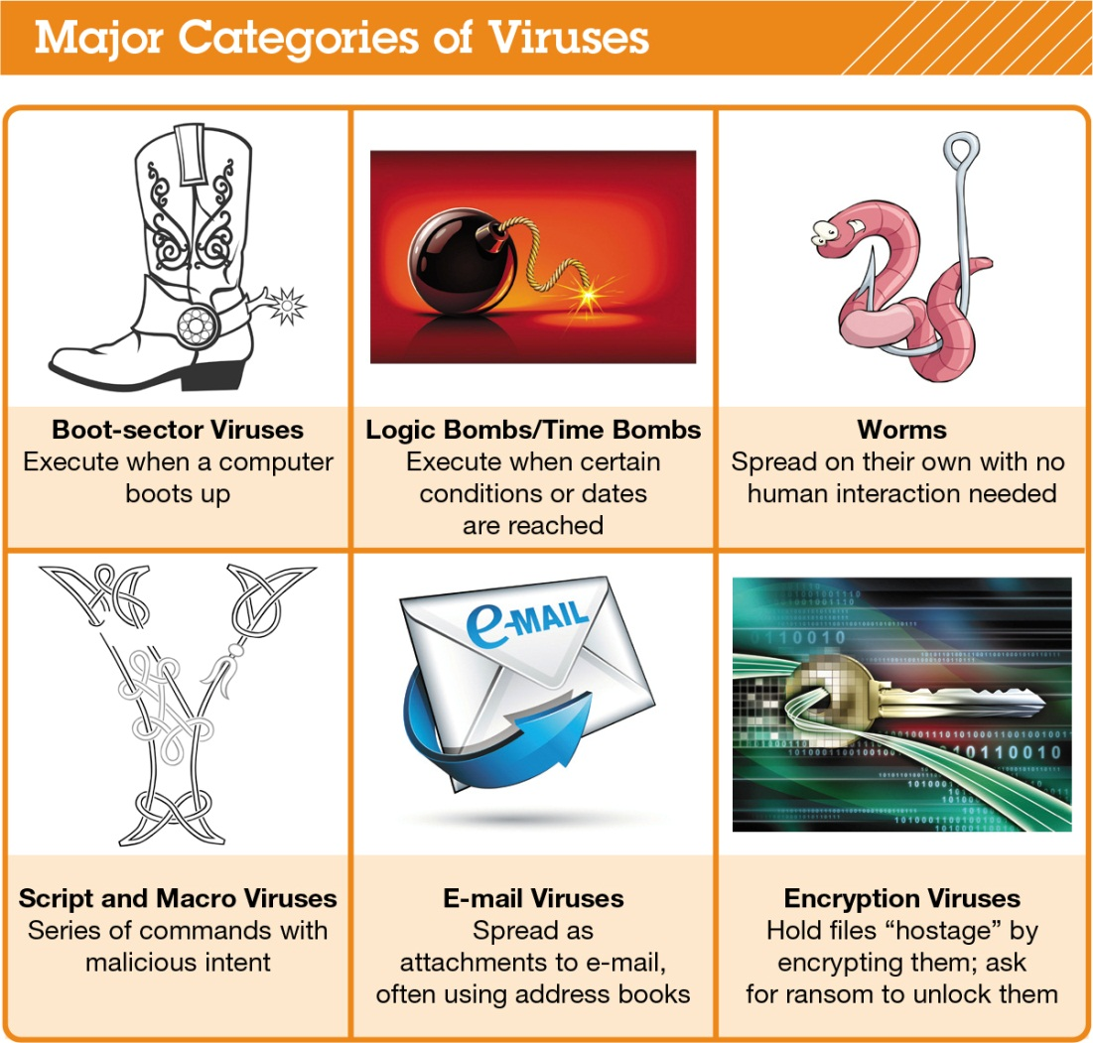
Computer Viruses (cont.)
Notes:
Thousands of computer viruses and variants exist
They can be grouped into six broad categories based on their behavior and method of transmission.
Boot sector viruses
Logic Bombs & Time Bombs
Worms
Script & Macro Viruses
Email Viruses
Encryption Viruses

Slide 6
Computer Viruses: Boot-Sector Viruses
Boot-Sector Virus - replicates onto hard drive’s master boot record
Often transmitted by a flash drive
Notes:
A boot-sector virus replicates itself onto a hard drive’s master boot record.
The master boot record is a program that executes whenever a computer boots up
ensures that the virus will be loaded into memory immediately, even before some virus protection programs can load.
Boot-sector viruses are often transmitted by a flash drive left in a USB port.
When the computer boots up with the flash drive connected
the computer tries to launch a master boot record from the flash drive
This is the trigger for the virus to infect the hard drive.

Slide 7
Computer Viruses: Logic Bombs and Time Bombs
Logic bomb – triggered when certain conditions are met
Time bomb – triggered by passage of time or on certain date
Notes:
A logic bomb is a virus that is triggered when certain logical conditions are met, such as
opening a file
starting a program a certain number of times.
A time bomb is a virus that is triggered by the passage of time or on a certain date.

Slide 8
Computer Viruses: Worms
Worms
Independent of host file
Use file transport methods
Notes:
Although often called a virus, a worm is subtly different.
A virus infects a host file and waits until that file is executed to replicate and infect a computer system.
A worm, however, works independently of host file execution and is much more active in spreading itself.
In other words:
Viruses require human interaction to spread (e.g., opening an infected file)
Worms take advantage of file transport methods to spread itself
e.g., e-mail or network connections

Slide 9
Computer Viruses: E-Mail Viruses
E-Mail viruses
Distribution via address book
Melissa virus
Notes:
E-mail viruses use the address book in the victim’s e-mail system to distribute the virus.
The Melissa virus was the first practical example of an e-mail virus.
Released in 1999
For MSOutlook users, automatically resent the virus to the first 50 people in each user’s address book
Said to have infected up to 20% of computers worldwide
Not designed to destroy files, but had potential to disable corporate mail servers due to volume of email distribution

Slide 10
Computer Viruses: Encryption Viruses
Encryption viruses
Data files become encrypted and unusable
Ransom often requested
Notes:
encryption viruses run a program that searches for common types of data files (e.g., MS Word and Excel files)
compresses files using a complex encryption key that makes files unusable.
Affected users receive a message asking to send money to an account if you want to receive the program to decrypt your files.

Slide 11
Computer Viruses: Additional Virus Classifications
Classified by methods used to avoid detection
Polymorphic viruses – change code
Multipartite viruses – multiple file types
Stealth viruses – erase own code
Notes:
Viruses can also be classified by the methods they take to avoid detection by antivirus software:
Polymorphic viruses change their code to avoid detection.
Multipartite viruses are designed to infect multiple file types in an effort to fool the antivirus software.
Stealth viruses temporarily erase their code from the files where they reside and hide in the active memory (RAM) of the computer.
This helps to avoid detection if only the hard drive is searched for viruses.
Current antivirus software scans BOTH memory and hard drive.

Slide 12
Computer Viruses: Virus Symptoms
Program icons or files suddenly disappear
Unusual home page
New toolbars
Odd messages, pop-ups, or images
Data files become corrupt
Programs stop working properly
System slows or takes long time to boot up
Notes:
If your computer displays any of the following symptoms, it might be infected with a virus:
Existing program icons or files suddenly disappear.
You start your browser, and it takes you to an unusual home page or it has new toolbars.
Odd messages, pop-ups, or images are displayed on the screen, or strange music or sounds play.
Data files become corrupt. However, files can become corrupt for reasons other than a virus.
Programs stop working properly, which could be caused by either a corrupted file or a virus.
Your system slows down or takes a long time to boot up.

Slide 13
Preventing Virus Infections
Antivirus software
Detects virus signature
Stops virus execution
Quarantines virus
Inoculates (to prevent future infection)
Notes:
Antivirus software is specifically designed to detect viruses and protect your computer and files from harm.
The main functions of antivirus software are:
Detection: Antivirus software looks for virus signatures in files. A virus signature is a portion of the virus code that’s unique to a particular computer virus.
Stopping virus execution: If the antivirus software detects a virus signature, it stops the execution of the file and virus and notifies you. It also places the virus in a secure area on your hard drive; known as quarantining.
Prevention of future infection: In inoculation, the antivirus software records key attributes about your computer files and keeps these statistics in a safe place on your hard drive.

Slide 14
Managing Online Annoyances: Malware: Adware and Spyware
Malware (malicious software)
Viruses
Adware (greyware)
Spyware (greyware)
Tracking cookies
Keystroke logger
Notes:
Malware is software that has a malicious intent (hence the prefix mal). There are three primary forms of malware: viruses, adware, and spyware
Adware and spyware (aka grayware) are not physically destructive like viruses and worms (which can destroy data).
Adware is software that displays sponsored advertisements in a section of your browser window or as a pop-up box.
Spyware is an unwanted piggyback program that downloads with other software you install from the Internet and runs in the background of your system.
Spyware transmits information about you to the owner of the program.
Keystroke logger (key logger) monitors keystrokes with the intent of stealing passwords, login IDs, or credit card information.
Anti-spyware software detects unwanted programs and allows you to delete the offending software easily.
Anti-adware and anti-spyware available.

Slide 15
NETWORKING

Slide 16
Networking Fundamentals
Computer Network: 2+ computers connected via hardware and software
Node: any device connected to a network
Computer
Peripheral (e.g., printer, game console)
Network device (e.g., router)
Notes:
A computer network is simply two or more computers that are connected via software and hardware so that they can communicate with each other.
Each device connected to a network is referred to as a node.
A node can be a computer, a peripheral such as a printer or game console, or a network device such as a router.
Has anyone used an “un-networked” computer?
Separate printer for each
In lab, have to move to dedicated computer for printing
Switchbox with cables form printer to each computer
Software needed to be separately installed on each computer

Slide 17
Networking Fundamentals
Network benefits
Facilitates sharing of resources:
files
high-speed Internet connection
peripheral devices such as printers
common communications for different OS
Notes:
There are several benefits to having computers networked:
Sharing files: You can share files between networked computers without having to use portable storage devices such as flash drives to transfer the files.
Permissions can be set to allow different levels of access to each user (e.g., Y: drive)
Sharing an Internet connection: A network lets you share the high-speed Internet connection coming into your home.
Sharing printers and other peripherals: Networks let you share printers and other peripheral devices.
Common communications: Computers running different operating systems can communicate on the same network.

Slide 18
Networking Fundamentals
Home networks: after installation, easy to maintain
Large networks need to be administered
Installation of new computers and devices
Monitoring of network performance
Updating and installation of new software
Configuration of network security
Notes:
Fortunately, after most home networks have been set up, there isn’t much else that needs to be done to maintain or administer the network; therefore, the benefits of using a network outweigh the disadvantages.
However, large networks involve an initial purchase of equipment to set them up.
They also need to be administered, which can be costly and time consuming. Network administration involves tasks such as:
Installing new computers and devices
Monitoring the network to ensure it’s performing efficiently
Updating and installing new software on the network
Configuring, or setting up, proper security for a network
Benefits of large networks usually outweigh disadvantages

Slide 19
Networking Fundamentals
Data transfer rate (bandwidth): Maximum speed at which data can be transmitted between two nodes
Throughput: Actual speed of data transfer achieved
Measured in megabits per second (Mbps)
Notes:
Data transfer rate (also called bandwidth) is the maximum speed at which data can be transmitted between two nodes on a network.
Throughput is the actual speed of data transfer that is achieved.
Throughput is always less than or equal to the data transfer rate.
Data transfer rate and throughput are usually measured in megabits per second (Mbps). A megabit is 1 million bits.
Don’t confuse with MBps (megaBYTES per second). 1 MB = 8 Mb.
E.g., for an 1MB file, it will take throughput of 8 Mbps to download in 1 second.
Typically FILE SIZE in measured in MB(ytes), but TRANSFER RATES are measured in Mb(its) per second.

Slide 20
Network Architectures
Network architecture refers to the design of a network
Classified according to
Distance between nodes
How network is administered
Rules used to exchange data between nodes
Communications medium used to transport data
Notes:
The network you have in your home differs greatly in terms of its size, structure, and cost from that found across your college campus.
This difference is based in part on their network architectures.
Network architecture, or network designs, are classified according to the following characteristics:
The distance between their nodes
The way in which they are managed (or administered)
The set of rules (or protocol) used to exchange data between network nodes
The communications medium used to transport the data

Slide 21
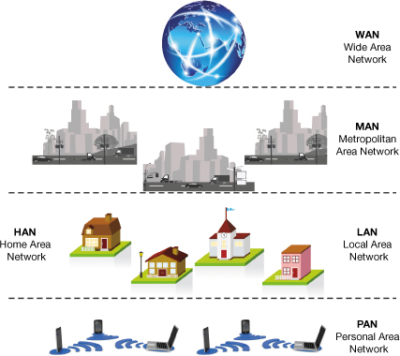
Network Architectures Defined by Distance
Networks can be classified by the distance between their nodes
Notes:
The distance between nodes on a network is one way to describe a network.

Slide 22
Network Architectures Defined by Distance (cont.)
Personal area network (PAN)
Local area network (LAN)
Home area network (HAN)
Metropolitan area network (MAN)
Wide area network (WAN)
Notes:
Personal Area Network (PAN)
network used for communication among devices close to one person
E.g., smartphones, notebooks, and tablets using Bluetooth and WiFi.
Local Area Network (LAN)
network in which the nodes are located within a small geographic area
E.g., computer lab, office building, restaurant
Home Area Network (HAN)
home-based LAN
used to connect home’s digital devices
E.g., computers, peripherals, phones, gaming devices, digital video recorders (DVRs), and televisions
Metropolitan Area Network (MAN)
large network designed to provide access to a specific geographic area, such as an entire city
Many U.S. cities are now deploying MANs to provide Internet access to residents and tourists
Wide Area Network (WAN)
spans a large physical distance
Internet is the largest WAN, covering the globe.
WAN is also a networked collection of LANs
E.g., multiple campuses located in different towns, each with its own LAN
When cables can no longer be used to connect, LAN becomes WAN
Required 3rd party service provider
LAN and WAN most important for exam.

Slide 23
Network Architectures Defined by Level of Administration
Central administration
Tasks can be performed from one computer and affect other computers on the network
Client/server network
Local administration
Configuration and maintenance must be performed on each individual computer attached to network
Peer-to-peer network
Notes:
A network can be administered, or managed, in either of two main ways: locally or centrally.
Central administration
tasks performed from one computer can affect the other computers on the network
E.g., software installation
In a client/server setup, a client is a computer on which users accomplish tasks and make requests, whereas the server is the computer that provides information or resources to the client computers.
E.g., Netflix server hosts the movies, clients access the movies
Typically an array of servers in different locations – each “mirrored” in case one goes down
Client can be redirected to identical content on different server if necessary
Local administration:
configuration and maintenance of the network must be performed on each individual computer attached to the network
E.g., peer-to-peer (P2P) network
each node connected on the network can communicate directly with every other node on the network
Thus, all nodes on this type of network are peers (equals).

Slide 24
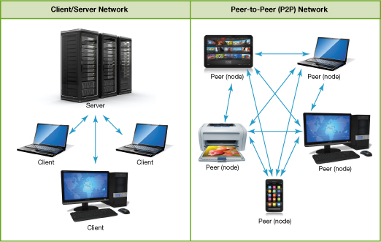
Network Architectures Defined by Level of Administration (cont.)
Notes:
This figure shows Client/Server and P2P Networks.

Slide 25
Network Architectures Ethernet Protocols
Ethernet network
Uses Ethernet protocol for communication
802.3: Standard for wired Ethernet networks
802.11: Standard for wireless Ethernet networks (i.e., Wi-Fi)
Current versions: 802.11n, ac
Previous versions: 802.11g, b, a
Notes:
Establishing standards for networking is important so that devices from different manufacturers will work well together.
An Ethernet network uses the Ethernet protocol as the means (or standard) by which the nodes on the network communicate.
The Ethernet protocol was developed by the Institute of Electrical and Electronics Engineers (IEEE), which develops many standard specifications for electronic data transmission that are adopted throughout the world.
The standard for wired Ethernet networks is 802.3.
The standard for wireless Ethernet networks, also known as WiFi, is 802.11.
The current versions of wireless Ethernet are 802.11n and 802.11ac.
Previous versions included 802.11g, 802.11b, and 802.11a.
802.11ac is twice as fast as previous versions
Runs at a 5 GHz bandwidth (rather than 2.4 GHz)
Less susceptible to interference from other devices.

Slide 26
Network Architectures Ethernet Protocols (cont.)
Backward compatibility: Ability of current devices to use earlier network standards
E.g., 802.11g devices work with 802.11ac networks
Slower data transfer rates
Some frequency interference
Notes:
Devices using older standards, such as 802.11g, will still work with 802.11n networks
will operate with slower data transfer rates and might run into some frequency interference
The ability of current devices to use earlier standards in addition to the current standard is known as backward compatibility.
When purchasing a new router, ensure compatibility with older devices.

Slide 27
Network Architectures Ethernet Protocols (cont.)
Gigabit Ethernet Standard
Up to 1 gigabit per second (Gbps) data transfer rate
Most common wired Ethernet standard for home networks
10 gigabit Ethernet is available
Notes:
The most common wired Ethernet standard for home networks is 1 gigabit per second (Gbps).
Computers generally ship with gigabit Ethernet cards installed.
10 gigabit Ethernet is available, but primarily used in businesses with large data throughput needs.

Slide 28
Network Components
All networks must include
Means of connecting nodes to network (cables or wireless technology)
Special devices that allow nodes to communicate with each other
Software that allows network to run
Notes:
To function, all networks must include
A means of connecting the nodes on the network (cables or wireless technology)
Special hardware devices (e.g., router) that allow the nodes to communicate with each other and to send data
Software that allows the network to run.

Slide 29
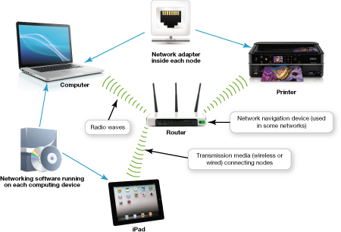
Network Components
Notes:
This figure shows network components.

Slide 30
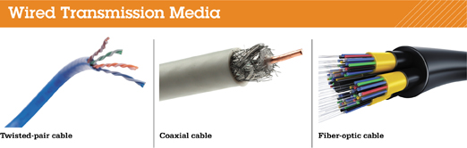
Network Components Transmission Media
Wireless networks use radio waves
Wired networks use cables to connect nodes
Notes:
All network nodes are connected to each other and to the network by transmission media. Transmission media can either be wired or wireless; they establish a communications channel between the nodes on a network.
Wired networks use various types of cable (wire) to connect nodes. The type of network and the distance between nodes determines the type of cable used
Unshielded twisted pair (UTP) cable is used for networks
Composed of four pairs of copper wires twisted around each other to reduce electrical interference
All cabling in CBA labs is UTP.
Coaxial cable consists of single copper wire surrounded by layers of plastic
if you have cable TV, the cable running into your TV or cable box is most likely coaxial cable.
Fiber-optic cable is made up of plastic or glass fibers that transmit data at extremely fast speeds
Each strand is thinner than human hair
Too expensive for residential use.
Cabling questions on exam

Slide 31
Network Components Transmission Media (cont.)
Wireless fidelity (WiFi) Standard for wireless transmissions using radio waves used to connect computing devices to wireless networks and the Internet
Notes:
Wireless fidelity (WiFi) is a standard for wireless transmissions using radio waves that is used to connect computing devices to wireless networks and the Internet.

Slide 32
Network Components Transmission Media (cont.)
Wireless networks generally have decreased throughput
More susceptible to interference
Buildings and metal can decrease throughput
Distance between networking equipment
Signal coding
Notes:
Wireless networks generally have decreased throughput compared with that of wired networks.
Here are some common reasons why wireless signals might have decreased throughput:
Wireless signals are more susceptible to interference from
magnetic and electrical sources
other wireless networks (e.g., your neighbor’s network)
Certain building materials (e.g., concrete, cinderblock, metal) can decrease throughput.
Throughput varies depending on the distance between your networking equipment.
Wireless networks usually use specially coded signals to protect their data
wired connections don’t protect their signals
This process of coding signals can slightly decrease throughput, although once coded, data travels at usual speeds.

Slide 33
Network Components Basic Network Hardware
Network adapter: Each node on a network needs an adapter to communicate
Network interface card (NIC): Network adapter installed inside a device
Modem: required for Broadband Internet
Cable or DSL (phone line)
Translates the broadband signal
Incorporated into many DSL routers
Notes:
NETWORK HARDWARE
For the different nodes on a network to communicate with each other and access the network, each node needs a network adapter.
All desktop and laptop computers (and many peripherals) sold today contain pre-installed network adapters
A pre-installed network adapter is called network interface card (NIC).
Most NICs included in computing devices today are built to use wireless media, but many can use wired media as well.
A broadband Internet connection requires a modem.
Depending on the type of broadband service you have, you’ll have either a cable modem or a DSL modem.
DSL (digital subscriber line)
The modem translates the broadband signal for use in transferring data over internet

Slide 34
Network Components Basic Network Hardware (cont.)
Packets: bundles of data sent through a network
For computers to communicate packets must flow between network nodes
Notes:
Data is sent through a network in bundles called packets.
For computers to communicate, these packets of data must be able to flow between network nodes.
Large data broken down and sent via separate routes.
Data reassembled at the end of the journey
In past, packets often went missing
E.g., Email arrives with content (part of message) missing
Now identical packets transmitted via multiple routes to ensure entire message will arrive

Slide 35
Network Components Basic Network Hardware (cont.)
Router: Transfers packets of data between two or more networks
Switch: Receives data packets and sends them to intended nodes on the same network
Notes:
Network navigation devices, such as routers and switches, facilitate and control the flow of data through a network.
A router transfers packets of data between two or more networks.
On a home network, you need a router to transfer data between your home network and the Internet (separate network).
If home network is wireless, must purchase router with wireless capabilities.
A switch acts like a traffic signal on a network. All routers sold for home use have integrated switches. Switches receive data packets and send them to their intended nodes on the same network (not between different networks).

Slide 36
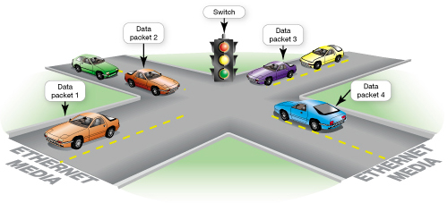
Network Components Basic Network Hardware (cont.)
Notes:
Switches act like traffic signals.
They enforce the rules of the data road on an Ethernet network
The help prevent data packets from crashing into each other.

Slide 37
Connecting to the Internet
Main reason for home network is to share an Internet connection
Must purchase Internet access from Internet service providers (ISPs)
Notes:
One of the main reasons for setting up a network is to share an Internet connection.
Some businesses and large organizations have a dedicated connection to the Internet
Smaller businesses and homeowners purchase Internet access from Internet service providers (ISPs).
ISPs might be:
specialized internet providers, or
companies that provide additional services, such as phone and cable TV
(e.g., Shaw, Telus)

Slide 38
Connecting to the Internet (cont.)
Connection choices
Broadband vs. Dial-up
Notes:
Broadband (aka high-speed Internet) refers to a type of connection that offers a faster means to connect to the Internet.
Dial-up uses conventional phone lines.
Dial-up has a maximum transmission speed of 56 Kbps (kilobits per second).
Broadband usually has a minimum data transmission rate of 5 Mbps (megabits per second)
Almost 100 times faster than dial-up
Fibre optic is 600 times faster than dial-up
Broadband is the preferred way to access the Internet, but in some situations cellular or dial-up access might be necessary.

Slide 39
Connecting to the Internet Wired Broadband Connections
Broadband
High-speed Internet
Data transmission rate of 5 Mbps or greater
Standard wired broadband technologies
Cable
Digital subscriber line (DSL)
Fiber-optic service
Notes:
Wired broadband can be provided via:
Cable
digital subscriber line (DSL) – telephone line
fiber-optic service – limited business access

Slide 40
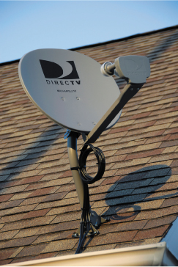
Connecting to the Internet Wired Broadband Connections (cont.)
Satellite broadband used in rural and mountain areas
Mobile broadband is offered by cell-phone service providers (3G or 4G)
Notes:
Satellite broadband is used mostly in rural or mountain areas that can’t get DSL, cable, or fiber-optic service.
Requires satellite dish connected to computer via coaxial cable
Mobile broadband is offered through many cell-phone service providers through 3G and 4G networks.
3G and 4G can be thought of as “WiFi everywhere” in that they provide Internet access to your mobile devices in the same way they provide voice service to your mobile phone.
3G and 4G refer to the third and fourth generations of cell-phone networks.
Higher number is newer technology (faster than predecessor)
4 LTE is actually between 3G and 4G.

